Slide 1

IST 261 (Fall 2019)
Application Development Design Studio I
Formatting Code
Phil O'Connell
pxo4@psu.edu

Slide 2
Why Should You "Format" Your Code?
Readability
Makes it much easier to determine what the code is doing
Finding typos
Missing characters like { ; and ( can cause formatting misalignments
Conformity and Consistency
Programming teams should agree on what type of formatting

Slide 3
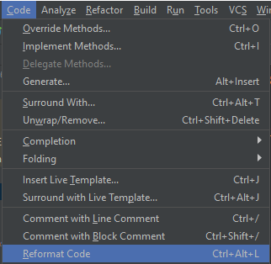
IntelliJ IDEA
IDEA seems to default to "compact" formatting
Uses less newline characters
So, less number of lines overall
I tend to prefer that
And most code I find does it that way
To format code in IDEA, choose Code > Reformat Code -or- Hit Ctrl+Alt+L

Slide 4
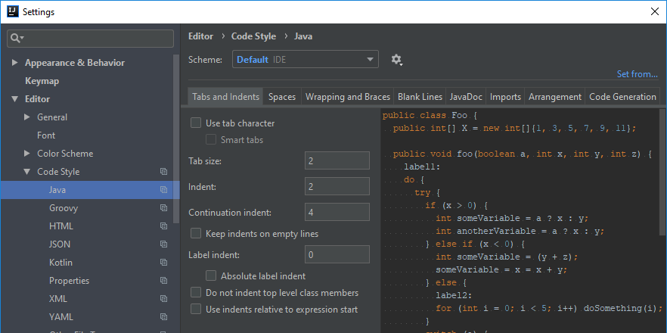
Example Settings: Tabs and Indents
I recommend NOT using tabs

Slide 5
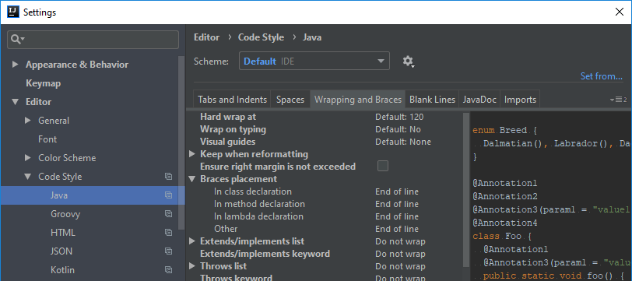
Example Settings: Wrapping and Braces

Slide 6
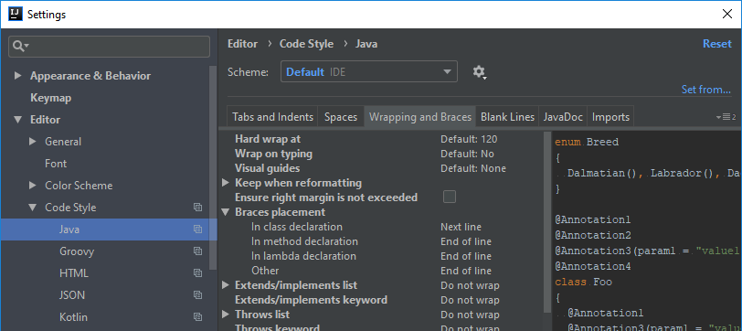
Example Settings: Wrapping and Braces

Slide 7
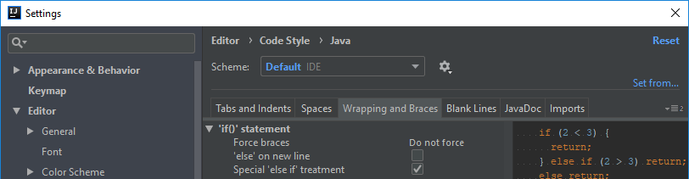
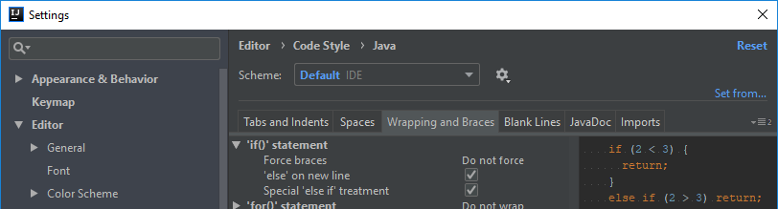
Example Settings: Wrapping and Braces

Slide 8
Example Settings: Wrapping and Braces

Slide 9
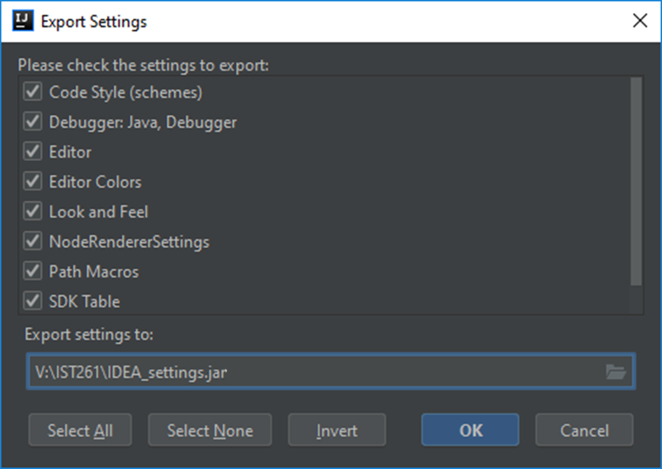
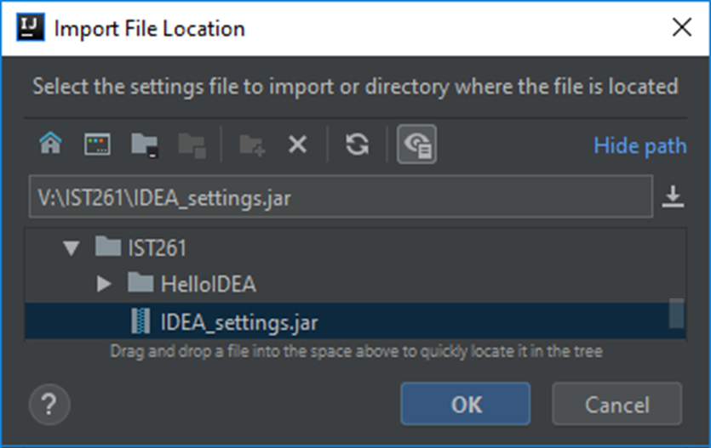
Importing/Exporting Settings
Helpful to ensure everyone on the team uses the same settings

Slide 10
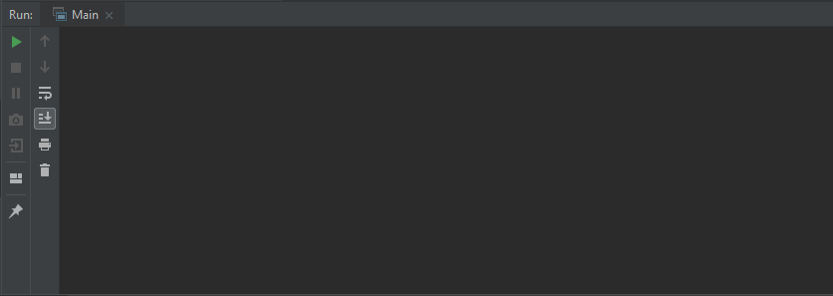
What Output Would You Get?
Given the code below, what would the output be?
public static void main(String[] args) {
int i = 0;
while (i <= 3)
System.out.println("i: " + i);
i++;
}
i: 0
i: 1
i: 2
i: 3

Slide 11
What Output Would You Get?
Look at the braces
public static void main(String[] args) {
int i = 0;
while (i <= 3)
System.out.println("i: " + i);
i++;
}
i:0
i:0
i:0
i:0
i:0
i:0
i:0
i:0
i:0
i:0
This will be the output
The loop will repeat forever, since i is adjusted outside the loop body
This brace matches main's

Slide 12
What Output Would You Get?
What is the actual block of the while loop?
public static void main(String[] args) {
int i = 0;
while (i <= 3)
System.out.println("i: " + i);
i++;
}
i:0
i:0
i:0
i:0
i:0
i:0
i:0
i:0
i:0
i:0
This is the one-line block of the while loop because there are no braces
Just because you align it under the while doesn't mean it ends that loop

Slide 13
What Output Would You Get?
Given the code below, what would the output be?
public static void main(String[] args) {
int i = 0;
while (i <= 3) {
System.out.println("i: " + i);
i++;
}
}
i: 0
i: 1
i: 2
i: 3
This is the two-line block of the while loop

Slide 14
Always Format Your Code
Make sure all your code is formatted
It makes life much easier for everyone who needs to read it
Unformatted code can cause many red herrings

